Slide 1
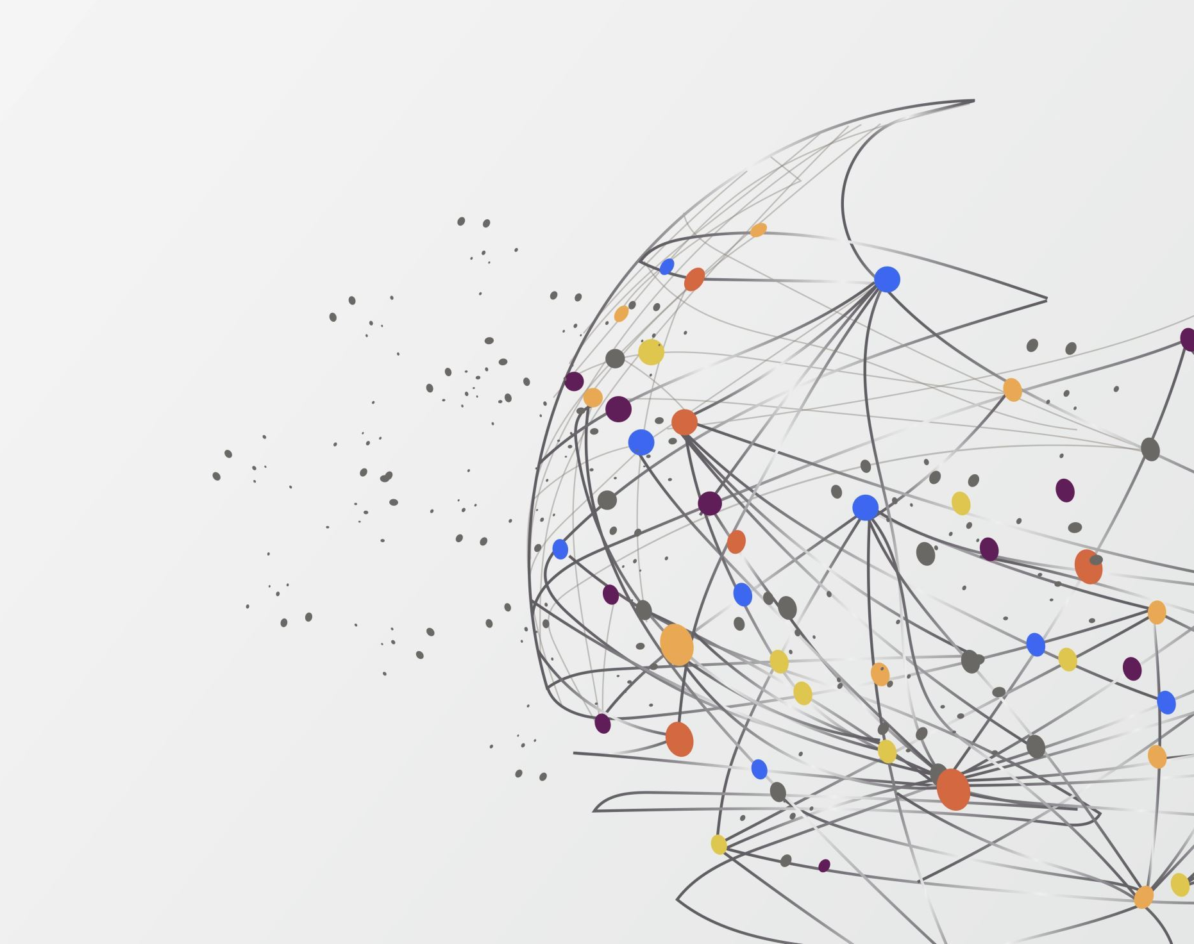
Research Project – Machine Learning using Python
Course Title : Advanced Topics - Web Dev
Mahfuzur Rahman and Pablo Quintana

Slide 2

Alan Turing
AI – A little history
“On Computable Numbers” (1936)
Describing What Came to be Called the "Turing Machine"

Slide 3
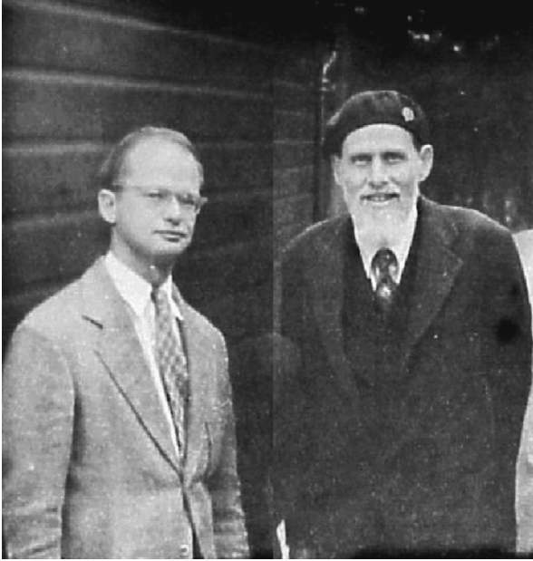
Warren McCullough and Walter Pitts
AI – A little history
“A Logical Calculus of the ideas Imminent in
Nervous Activity” (1943)
The first mathematical model of a neural network

Slide 4
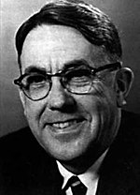
Arthur Samuel
AI – A little history
He popularized the term "machine learning" in 1959
The Samuel Checkers-playing Program was among the
world's first successful self-learning programs

Slide 5
AI Winter and Big Data
AI – A little history
From 1974 to 1980, AI funding declined drastically, making this time known as the First AI Winter.
Interest in AI wouldn't be revived until years later with the advent of expert systems.
This would eventually end with another AI winter from the late 1980s to mid-90s.
After that, advances in computing power and Big data allowed researchers to develop more sophisticated learning algorithms, powering AI until today.

Slide 6
What is Machine Learning?
Is a branch of artificial intelligence.
Gives computers the ability to learn without explicitly being programmed.
Machine learning starts with data — numbers, photos, or text, like bank transactions, pictures of people or even bakery items, repair records, time series data from sensors, or sales reports.
Use supervised, unsupervised, and Reinforcement learning.
Supervised learning uses labeled training data, and unsupervised learning does not. Reinforcement trains machines through trial and error to take the best action by establishing a reward system.
Can be descriptive, meaning that the system uses the data to explain what happened; predictive, meaning the system uses the data to predict what will happen; or prescriptive, meaning the system will use the data to make suggestions about what action to take.
Definitions

Slide 7
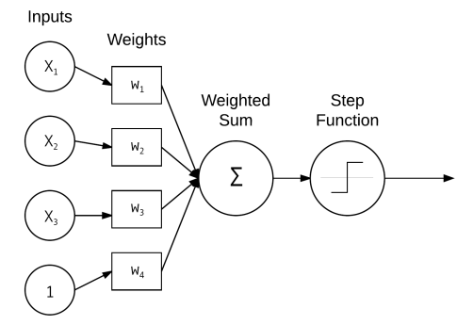
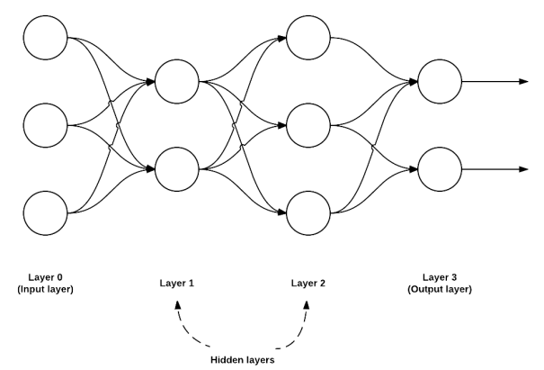
What is Neural Networks?
Neural networks are a subfield of machine learning.
The idea behind neural networks was first born in the 1950s with the perceptron algorithm.
A perceptron is a simplified model of a human neuron that accepts an input and performs a computation on that input.
The output is then fed to an activation function, which decides whether the neuron will “fire” based on the output value.
Using an algorithm known as backpropagation, the neural network can adjust the influence of any particular node in the network, attempting to reduce the errors that the network makes when calculating a final result.
Definitions
Feedforward Network Architectures

Slide 8
Types of Deep Neural Networks?
Convolutional Neural Networks (CNNs)
Frequently used for the tasks of image classification.
Definitions
Recurrent Neural Networks (RNNs)
strong choice for building up sequential representations of data over time: tasks such as document translation, voice recognition, sentiment analysis, and Natural Language Processing (NLP).
A famous algorithm used is Long Short-Term Memory (LSTM).

Slide 9
ML Algorithms
Supervised Learning
Linear Regression | Stock Price Prediction, Predicting housing prices, Predicting customer lifetime value.
Logistic Regression | Predicting credit risk score, Customer churn prediction.
Decision Tree | Customer churn prediction, Credit score modeling, Disease prediction.
Random Forests | Credit score modeling, Predicting housing prices.
Support Vector Machines (SVMs) | Intrusion detection, email classification, bioinformatics, finance for predicting stock prices
Artificial Neural Network | Computer Vision, Natural Language Processing.
Applications
Unsupervised Learning
K-Means | Customer segmentation, Recommendation systems.
Hierarchical Clustering | Fraud detection, Document clustering based on similarity.
Gaussian Mixture Models | Customer segmentation, Recommendation systems.
Apriori Algorithm | Product placements, Recommendation engines, Promotion optimization.
Artificial Neural Network | Clustering, data dimensionality reduction, and segmentation

Slide 10








Deep Learning and Computer Vision
Computer Vision Applications
Face Recognition | Object Detector
Object Classification | Object Tracking
Medical imaging processing | Autonomous vehicles
Augmented reality | Manufacturing
Python and library tools

Slide 11
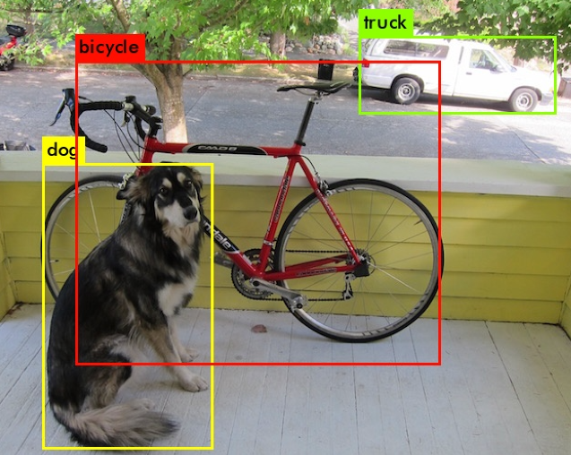
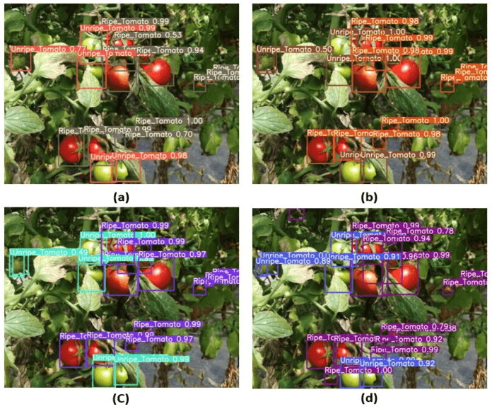
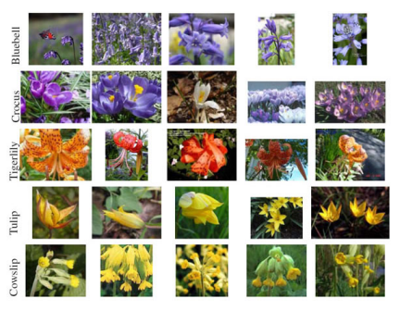
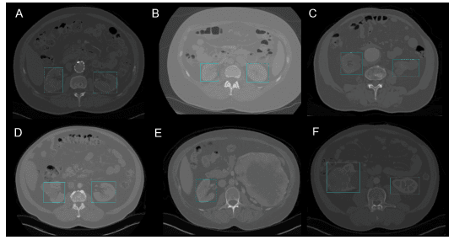
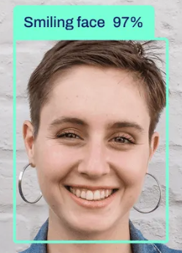
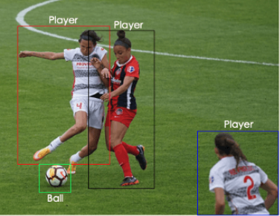
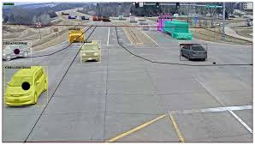
Computer Vision
Examples

Slide 12
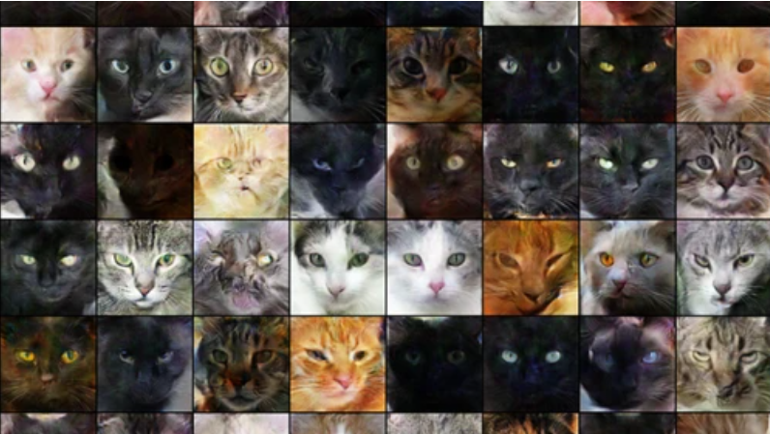
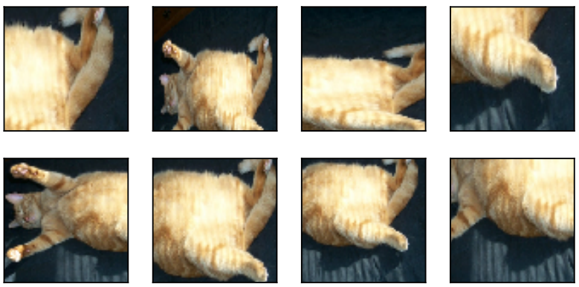
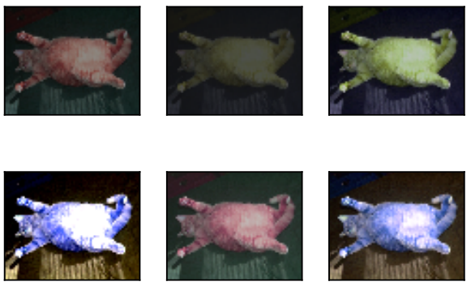
Convolutional Neural Networks
Important objectives to achieve in the design of a neural networks
Goals/Objectives
Avoid overfitting (“memorize” the training data to well)
Be able to generalize with new data
Yes, it's a cat!
Data is important
“I was not trained with images with different orientations, lighting, and positions.”

Slide 13
Convolutional Neural Networks
Important objectives to achieve in the design of a neural networks
Goals/Objectives
This is an optimization problem, and many hyperparameters participate in the design of the neural network.
In addition, we can control overfitting by tuning the hyperparameters according to the model to be developed.
so, the models learn and find convergence.
Layer size
Magnitude (learning rate)
Regularization (dropout)
Activations (activation function)
Weight initialization strategy
Loss functions
Settings for epochs during training
Normalization scheme for input data (vectorization)

Slide 14
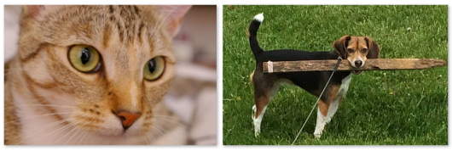

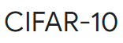
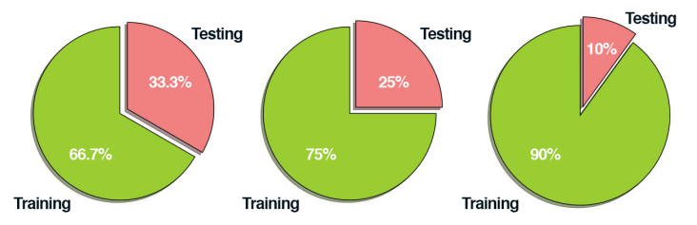
Convolutional Neural Networks
Classification Pipeline Process
How does it work?
A classic problem to classify a dog and a cat
Step #1: Gather your Dataset (Images and labels)
Step #2: Split your Dataset (training and testing set)
Step #3: Train Your Network
Step #4: Evaluate
Using test datasets only to evaluate your network

Slide 15
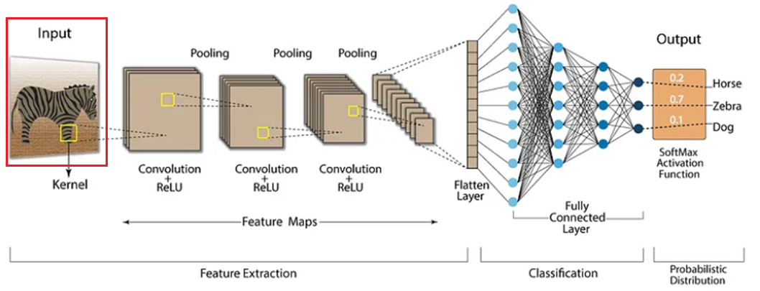
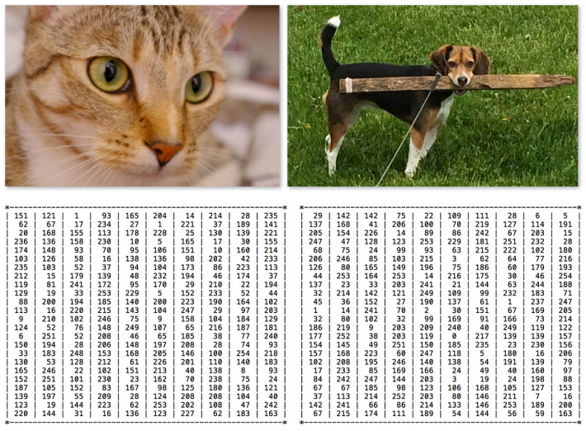
Convolutional Neural Networks
Input Layers
How does it work?
The image is transformed into a matrix of pixels
W x H x depth
Input image must be square to take advantage of linear algebra optimization libraries.
Common input layer sizes include 32 × 32, 64 × 64, 96 × 96, 224 × 224,
227 × 227 and 229 × 229

Slide 16
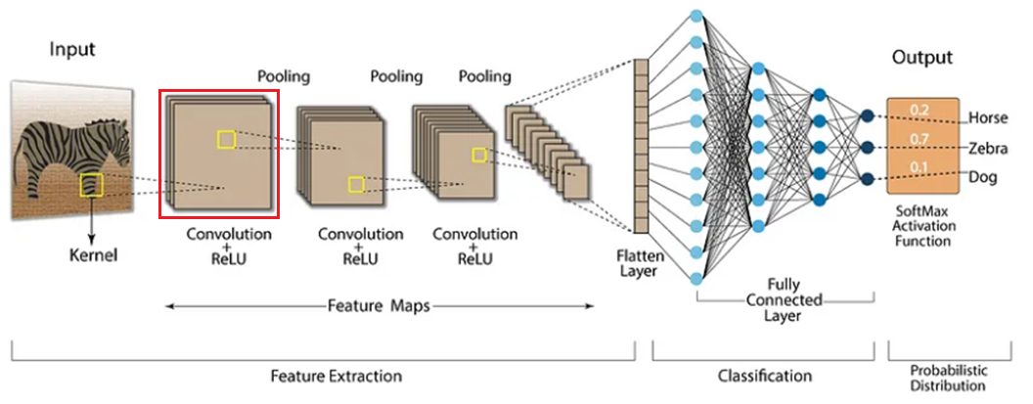
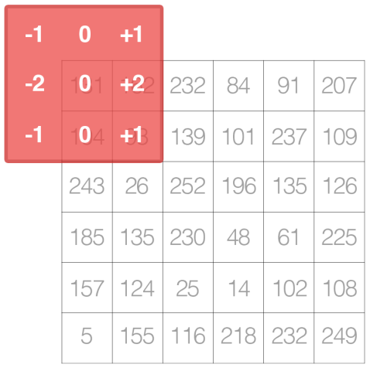
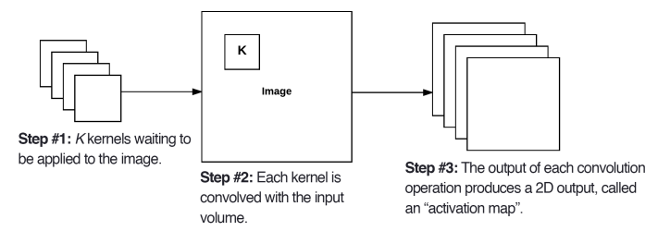
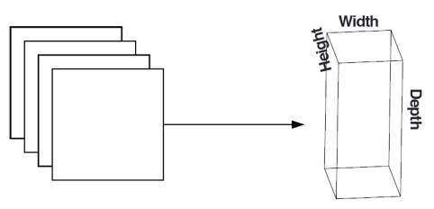
Convolutional Neural Networks
Convolutional Layers
How does it work?
“sliding” the kernel from left-to-right and top-to-bottom,
one pixel at a time.
Common filter sizes such as 3 × 3 and 5 × 5
Activation maps are stacked together to form the input volume

Slide 17
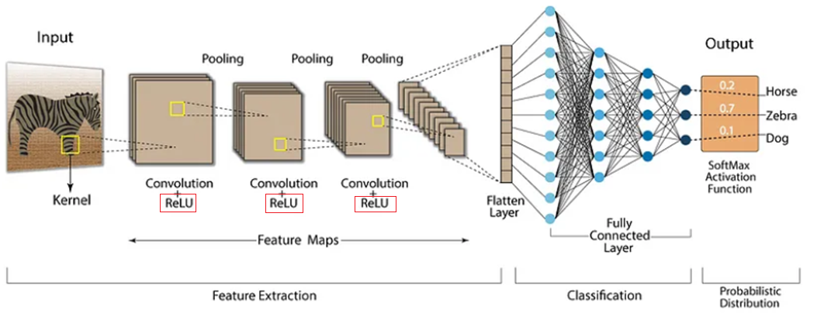
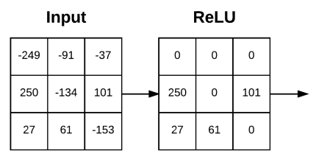
Convolutional Neural Networks
Activation function
How does it work?
“sliding” the kernel from left-to-right and top-to-bottom,
one pixel at a time.
ReLU

Slide 18

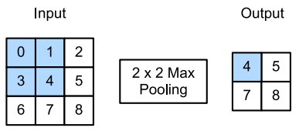
Convolutional Neural Networks
Pooling Layers
How does it work?
The primary function of the POOL layer is to progressively reduce the spatial size (i.e., width and height) of the input volume.
a function that summarizes the most important information of the activation map.
Also, it reduces computation in the network and controls overfitting.
“sliding” the pooling window from left-to-right and top-to-bottom of the input array.

Slide 19
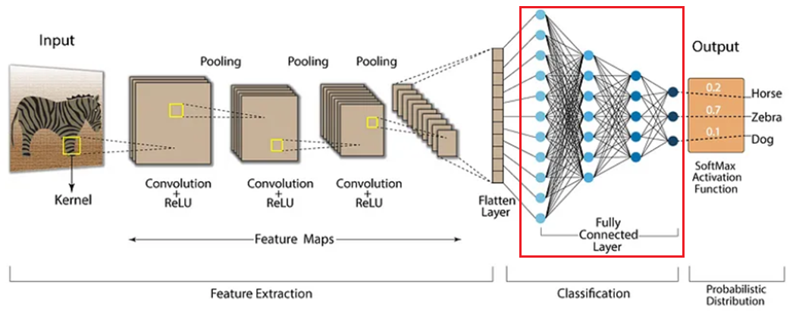
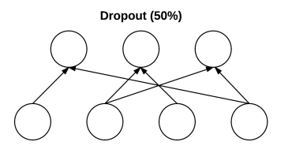
Convolutional Neural Networks
Fully-connected Layers
How does it work?
Helps our model to generalize and prevent overfitting.
Dropout is driven by randomly dropping a neuron so that it will not contribute to the forward pass and backpropagation.
Mute parts of the input to each layer, such that the neural network learns other portions.
Helps modify the gradient so that it doesn’t step in directions that lead it to overfit.

Slide 20
References
https://www.ibm.com/topics/machine-learning
https://www.techtarget.com/searchenterpriseai/definition/machine-learning-ML
https://www.simplilearn.com/tutorials/deep-learning-tutorial/what-is-deep-learning

